Slide 1

DSLab
The Data Science Lab
Spring 2020 – week #9

Slide 2
Stream Processing
Spring 2020 - week #10

Slide 3
Stream Processing Module
Objectives
Review concepts of stream processing
Experiment with typical tools for
Data ingestion and processing
Week 10
Concepts
Experiments
Week 11
Advanced topics
Operations on streaming data (joins)
Time constraints
Homework

Slide 4
Reminder: Concepts
Event Time vs Processing Time
Windowing
Fixed
Sliding
Count-based vs time-based
Transformations
Stateful / Stateless operations

Slide 5
Processing Time vs Event Time
Event Time
Processing Time
delay

Slide 6
Processing Time vs Event Time
Event Time
Processing Time

Slide 7
Processing Time vs Event Time
1
4
5
2
3
6
Event Time
1, 2, 3, 4, 5, 6, …
1
5
2
6
4
3
Processing Time
2, 3, 1, 6, 5 , 4, …

Slide 8
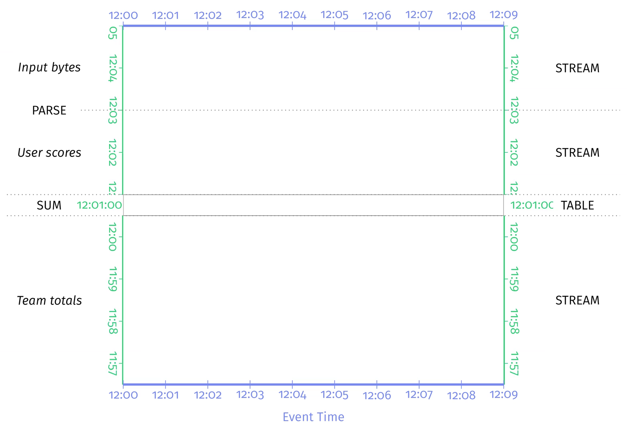
Processing Time vs Event Time
Credits: Tyler Akidau (et al.), Streaming Systems, O’Reilly Media, 2018.

Slide 9
Processing Time vs Event Time
Credits: Tyler Akidau (et al.), Streaming Systems, O’Reilly Media, 2018.
Notes:
Out of order
Variable time skew

Slide 10
Processing Time vs Event Time
Credits: Tyler Akidau (et al.), Streaming Systems, O’Reilly Media, 2018.
Notes:
Out of order
Variable time skew
Watermark: set boundaries to drop late data beyond watermark (ensure some completeness)

Slide 11
In Spark Streaming
Count on a sliding window of 10 minutes long with 5 minutes sliding interval.
from pyspark.sql.functions import *
windowedAvgDF = \ eventsDF \ .groupBy(window("eventTime", ”10 minute”, "5 minute")) \ .count()

Slide 12
In Spark Streaming
Count on a sliding window of 10 minutes long with 5 minutes sliding interval with 10 minutes watermarking (lateness).
from pyspark.sql.functions import *
windowedAvgDF = \ eventsDF \ .withWatermark("eventTime", "10 minutes") \ .groupBy(window("eventTime", "10 minutes", "5 minutes")) \ .count()

Slide 13
Transformations
How it works
DStream: continuous stream of data
Created from inputs (e.g. Kafka) or derived from other DStreams
Supports transformations like RDDs
(map, count, join, etc)
Image credits: https://spark.apache.org/docs/latest/streaming-programming-guide.html
Notes:
Spark Streaming receives live input data streams and divides the data into (micro) batches, which are then processed by the Spark engine to generate the final stream of results in batches.

Slide 14
Transformations: Joins
Joins:
On two streams over a common key
Example: Ad monetization (*)
Source: Databricks Engineering Blog, by Tathagata Das and Joseph Torres , https://bit.ly/2I58Ve7
Notes:
Spark Streaming receives live input data streams and divides the data into (micro) batches, which are then processed by the Spark engine to generate the final stream of results in batches.

Slide 15
Transformations: Joins
from pyspark.sql.functions import expr
# Define watermarks
impressionsWithWatermark = impressions \
.selectExpr("adId AS impressionAdId", "impressionTime") \
.withWatermark("impressionTime", "10 seconds ") # watermark: max 10 seconds late
clicksWithWatermark = clicks \
.selectExpr("adId AS clickAdId", "clickTime") \
.withWatermark("clickTime", "20 seconds") # watermark: max 20 seconds late
# Inner join with time range conditions
impressionsWithWatermark.join(
clicksWithWatermark,
expr("""
clickAdId = impressionAdId AND
clickTime >= impressionTime AND
clickTime <= impressionTime + interval 1 minutes
""” # aggregation interval: 1 minute
)
)
Source: Databricks Engineering Blog, by Tathagata Das and Joseph Torres , https://bit.ly/2I58Ve7
Notes:
Spark Streaming receives live input data streams and divides the data into (micro) batches, which are then processed by the Spark engine to generate the final stream of results in batches.

Slide 16
Homework
Gitlab project URL
Add link to Homework (Renku project)

